Slide 1
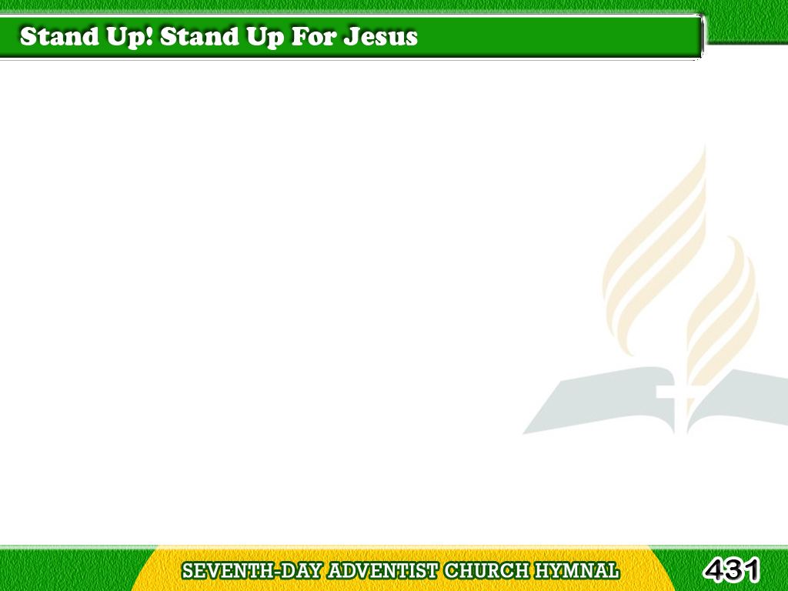
1/4
Stand up! stand up for Jesus!
Ye soldiers of the cross;
Lift high His royal banner,
It must not suffer loss;
Tagalog
Version

Slide 2
1/4
From victory unto victory,
His army shall He lead,
Till every foe is vanquished,
And Christ is Lord indeed.
Tagalog
Version

Slide 3
2/4
Stand up! stand up for Jesus!
The trumpet call obey;
Forth to the mighty conflict,
In this His glorious day.
Tagalog
Version

Slide 4
2/4
Ye that are his now serve Him
Against unnumbered foes;
Let courage rise with danger,
And strength to strength oppose.
Tagalog
Version

Slide 5
3/4
Stand up! stand up for Jesus!
Stand in His strength alone;
The arm of flesh will fail you;
Ye dare not trust your own.
Tagalog
Version

Slide 6
3/4
Put on the gospel armor,
And, watching unto prayer,
Where duty calls, or danger,
Be never wanting there.
Tagalog
Version

Slide 7
4/4
Stand up! stand up for Jesus!
The strife will not be long;
This day the noise of battle,
The next the victor’s song.
Tagalog
Version

Slide 8
4/4
To him that over cometh,
A crown of life shall be;
He with the King of glory
Shall reign eternally.
Tagalog
Version

